Slide 1

Lecture_4
Preparing Data for Analysis
Matthew Valentine
Office: Tech Room Lab K2
mvalentine@uwc.ac.za

Slide 2

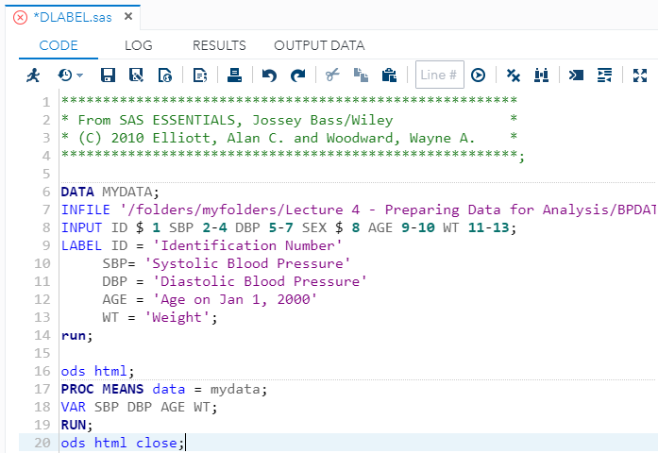
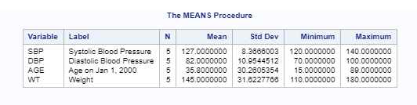
Labelling and Analysing Variables
SAS Labels are used to provide descriptive names for variables Data sets often contain cryptic variable names such as ID, SBP, WT, etc…
To produce something that’s readable, creating explanatory labels for the variables is good practice.
In SAS this can be accomplished by using the LABEL statement.
The LABEL Statement Syntax are as follows;
You can use Double or Single quotation marks in the LABEL statement.
LABEL VAR1 = "A new label number 1"
VAR2 = "A new Label number 2"
Example: In the editor window, open the file DLABEL.SAS

Slide 3
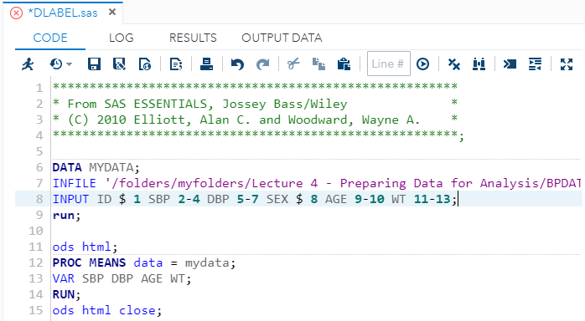
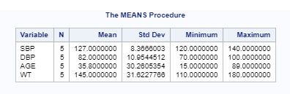
Labelling and Analysing Variables

Slide 4
Creating new Variables
It is common to calculate new variables in a dataset in preparation for analysis.
Example; You may need to convert a temperature reading from Fahrenheit to Celsius.
One method for creating new variables in your dataset is to calculate them within the DATA step.
You can create new variables within a SAS DATA statement by assigning a value to a new variable name or by calculating a new variable using a mathematical or logical operator/expression.
Creating Numeric Variables in the DATA step
These calculations use standard arithmetic operators as defined here:
+ Addition
- Subtraction
* Multiplication
/ Division
** Exponentiation
Examples;
Sum = X + Y
DIFF = X - Y

Slide 5
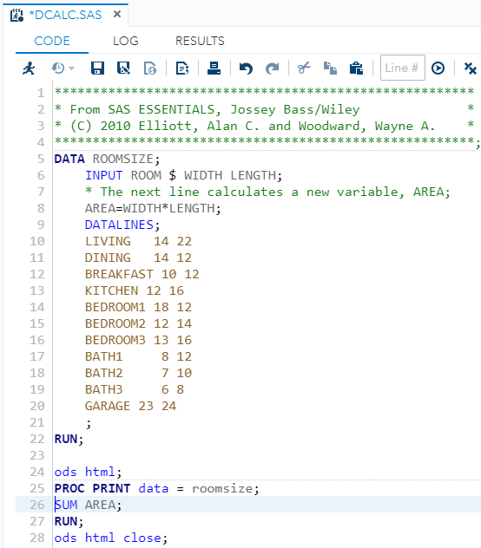
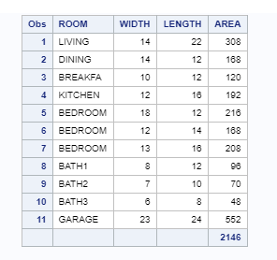
Creating new Variables
The following example will be looking at how to calculate a new value for each record in your dataset by using a simple arithmetic expression, by multiplying two variables (WIDTH and LENGTH) that are in the dataset to create a New Variable (AREA)
When doing calculations in says remember that it calculates Parentheses, Exponents, Multiplication, Division, Addition and then Subtraction.
Example: In the editor window, open the file DCALC.SAS

Slide 6
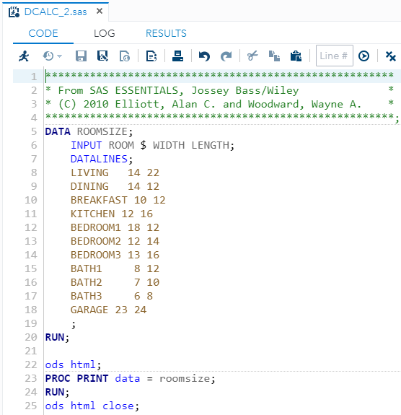
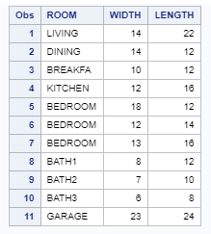
Example: In the editor window, open the file DCALC.SAS

Slide 7
SAS Functions
Functions that can be used when assigning variables
Form: variable = function(argument1, argument2,…);
Some important functions:
S = INT(x);
S = MAX(x1, x2, x3, …);
S = MIN(x1, x2, x3, …);
S = SUM(x1, x2, x3, …);
S = ROUND(x,round);
S = INTCK(‘interval’,startdate, enddate);
Some important functions:
S = INTCK(‘interval’,startdate, enddate);
S = MDY(month, day, year);

Slide 8
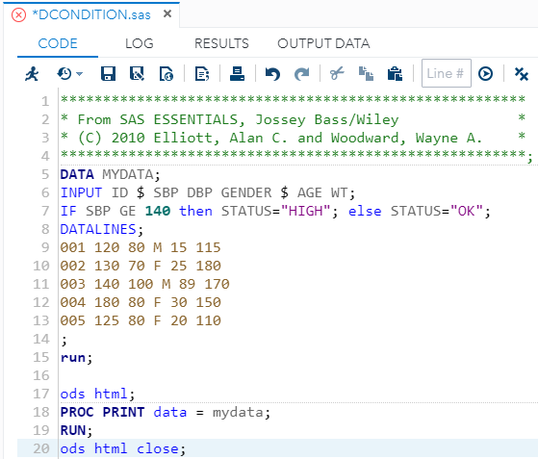
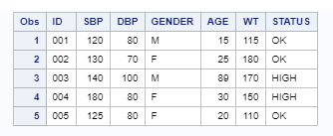
Using IF-THEN-ELSE Conditional Statement Assignments
The Syntax for the IF-THEN-ELSE statement
If the systolic blood pressure (SBP) is greater than or equal to 140, the program assigns the value HIGH to the variable status. Otherwise, it assigns the value OK to that variable.
IF Expression THE statement;
ELSE statement;
Example: In the editor window, open the file DCONDITION.SAS

Slide 9
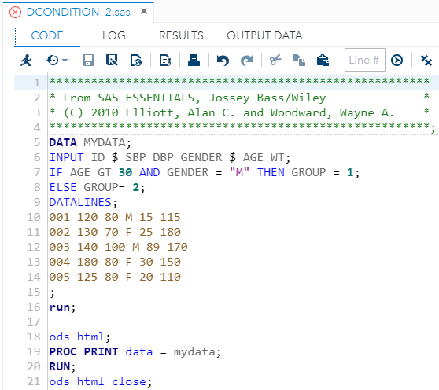
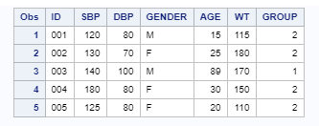
Using IF-THEN-ELSE Conditional Statement Assignments

Slide 10
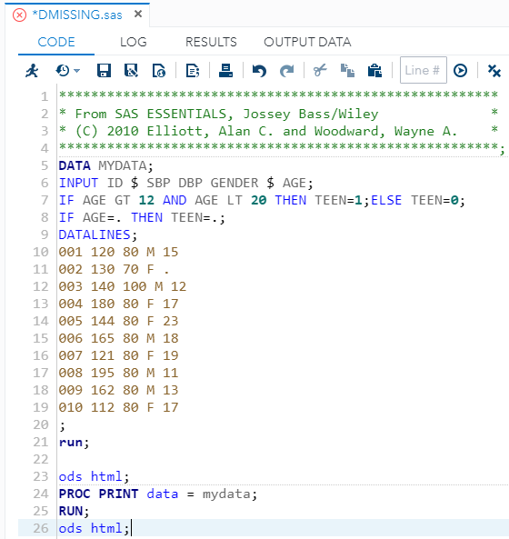
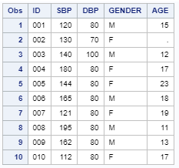
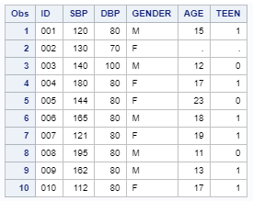
Using IF to assign missing values
An IF statement is a common way to specify missing values in a SAS DATA step.
For Example;
This indicates that if the value of AGE is equal to -9, the value of AGE is set to a missing value .(DOT), because there is no ELSE statement (Clause), the value of AFE is not changed when AGE is not equal to -9
To specify missing character value, use two quotations marks.
For Example;
IF AGE EQ -20 THEN AGE = .;
IF GENDER NE "M" AND GENDER NE "F" THEN GENDER = " ";
Example: In the editor window, open the file DMISSING.SAS

Slide 11
Using DROP and KEEP to select variables
In many cases you may have a dataset containing variables you do not want to keep.
The DROP and KEEP statements in the data step allow you to specify which variables to retain and those you retain in the dataset.
The syntax for KEEP and DROP statement are as follows;
In this instance it will read in all the data, but drop those that were specified namely; E and F.
DROP VARIABLES;
KEEP VARIABLES;
DATA MYDATA;
INPUT A B C D E F G;
DROP E F;
DATALINES;
/*...*/
Example: In the editor window, open the file DKEEP.SAS

Slide 12
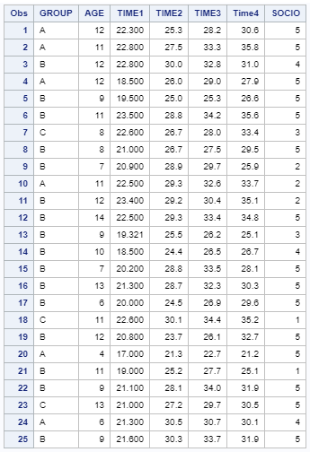
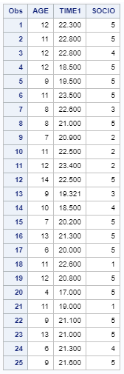
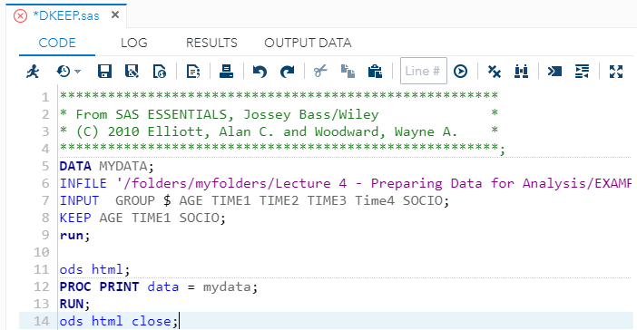
Using DROP and KEEP to select variables
Example: In the editor window, open the file DKEEP.SAS

Slide 13
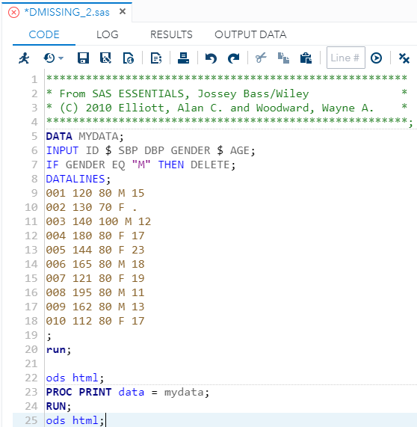
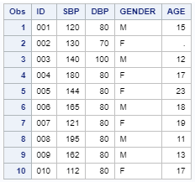
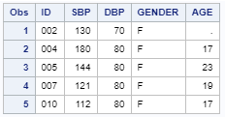
Sub-setting data sets
Datasets can be quite large. You may have a dataset that contains some group of subjects that you want to eliminate from your analysis. In that case, you can subset the data so it will contain only those records you need.
For Example; If your analysis concerns pregnancies, you may want to limit your dataset to females.
The data will not be deleted from the raw dataset but from the temporary dataset that was created.
IF GENDER EQ "M" THEN DELETE;
Example: In the editor window, open the file DMISSING.SAS

Slide 14
Using the set statement to read an existing dataset
Many times you will have a sourced dataset that comes from an organisation. If you do not want to change the original dataset then you can use the SET statement.
The SET statement in a DATA step is used to transfer data from an existing SAS dataset to a new one.
The SET statement allows one to
Create several other data sets through sub setting, but you want to keep the original SAS data set as well.
Create a new dataset starting with the data in a current dataset, but you want to preserve all data in the original dataset.
Example: In the editor window, open the file DSUBSET2.SAS

Slide 15
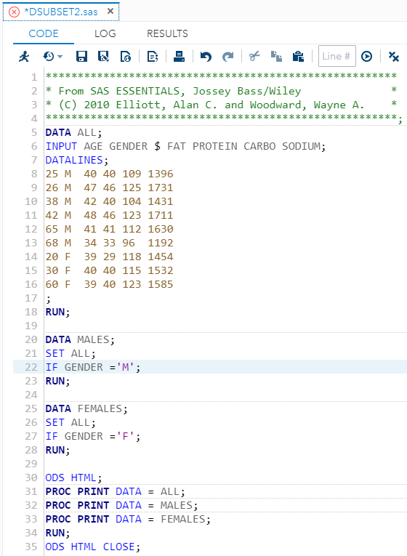
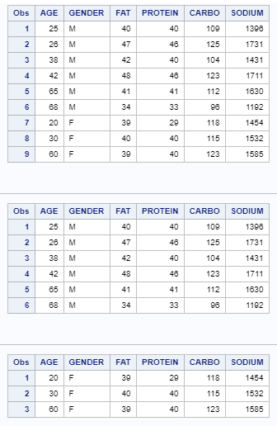
Using the set statement to read an existing dataset
Example: In the editor window, open the file DSUBSET2.SAS

Slide 16
Using PROC SORT
The SORT procedure can be used in the DATA step to rearrange the observations in a SAS dataset or create a new SAS dataset containing the rearranged observations.
With the PROC SORT, you can sort on multiple sort fields and sort in ascending or descending order.
The PROC SORT syntax is as follows;
The BY statement in the PROC SORT paragraph must contain one or variables, and optionally the descending keyword, because, SAS will automatically sort the data in ascending order. (Or you can put in the option Ascending, which will results in the same result.
PROC SORT 'OPTIONS'; BY VARIABLES(S);
/*OPTIONS INCLUDE;
DATA = DATASETNAME;
OUT=OUTPUTDATASETNAME;*/
Example: In the editor window, open the file DSORT.SAS

Slide 17
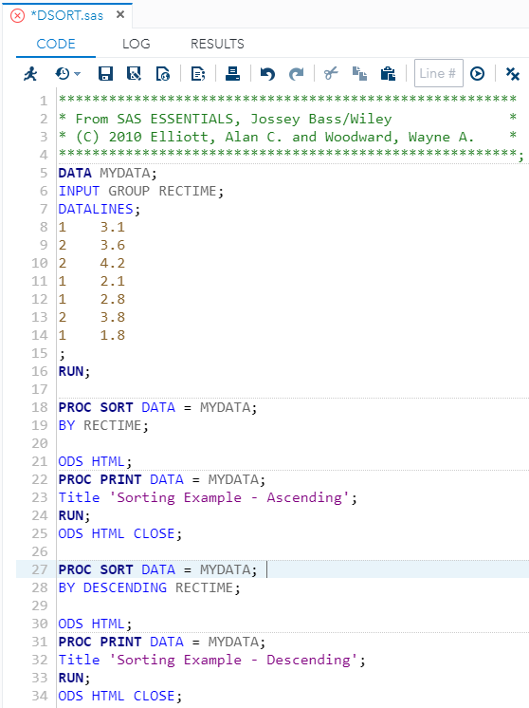
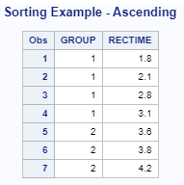
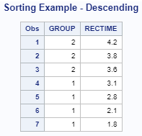
Using PROC SORT
Example: In the editor window, open the file DSORT.SAS

Slide 18
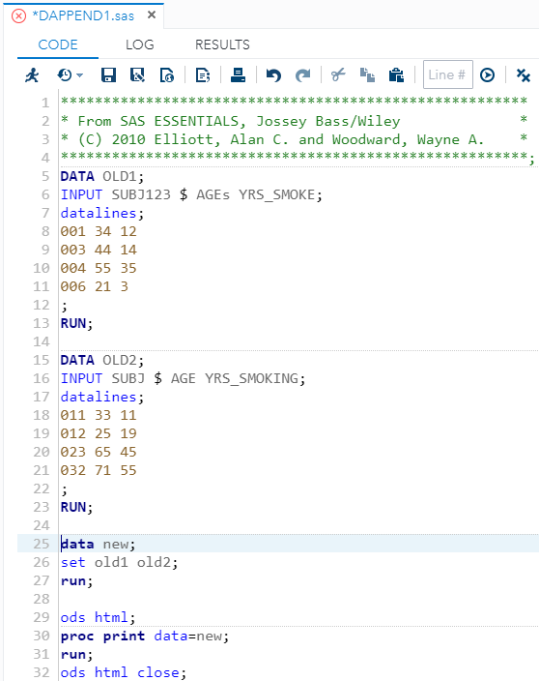
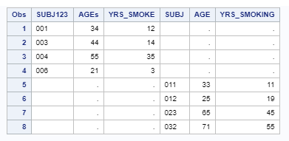
Appending datasets
Data sets can either be joined by appending or merging data sets to create a new data set.
By appending data sets, observations are merely added to a new data set.
By merging data sets, observations can joined by a common variable.
To APPEND data sets, use the SET statement.
To MERGE data sets, use the MERGE statement with the BY statement.
Example: In the editor window, open the file DAPPEND1.SAS

Slide 19
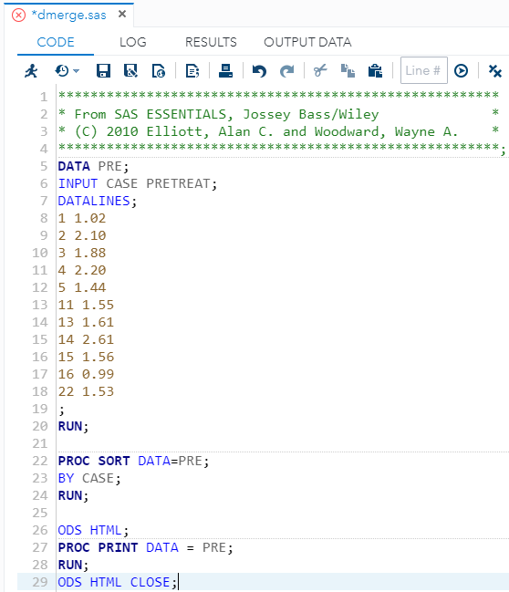
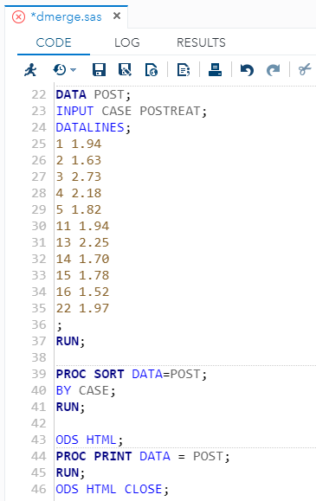
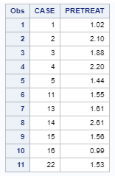
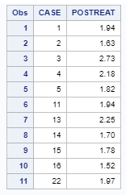
Merging datasets
Sort each dataset by the unique identifier.
Within a Data step, use MERGE statement along with the BY statement to merge the data by the unique identifier.
Example: In the editor window, open the file DMERGE.SAS

Slide 20
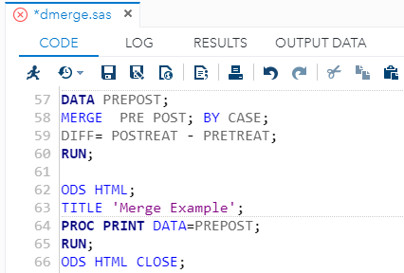
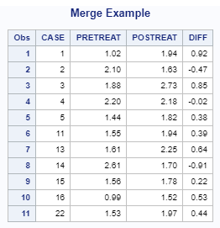
Merging datasets
Example: In the editor window, open the file DMERGE.SAS

Slide 21
Study
Chapter 4
Matthew Valentine
Office: Tech Room Lab K2
Mvalentine@uwc.ac.za

